Slide 1
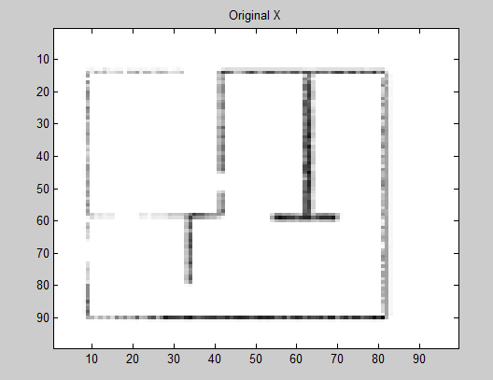
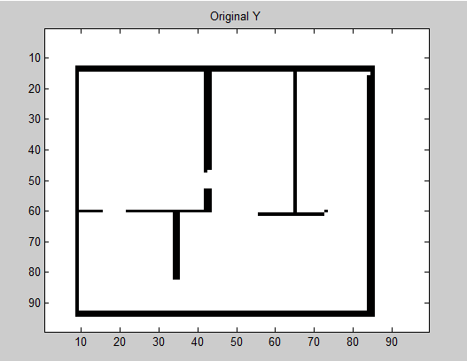
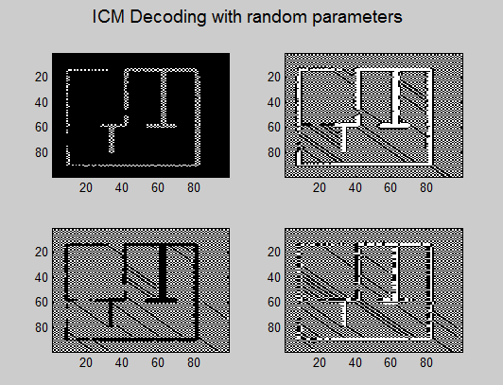
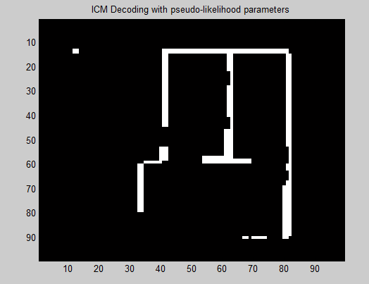
UGM Train Approx – Pseudo-likelihood training
Edge pot = [2.1816,1,1,2.1816]
Node pot = [1.1003,1]

Slide 2
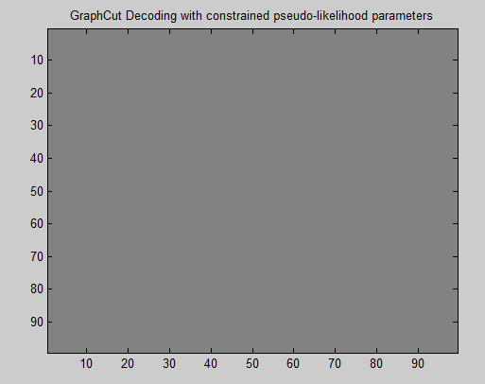
UGM Train Approx – Pseudo-likelihood & Associative CRF
Edge pot = [2.5170,1,1,2.5170]
Node pot = [0.7827,1]

Slide 3

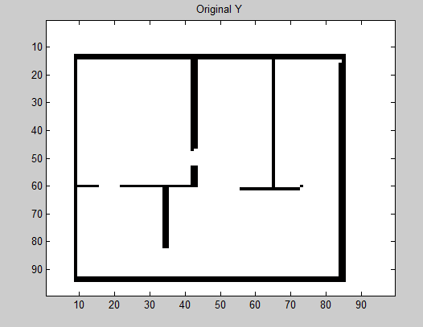
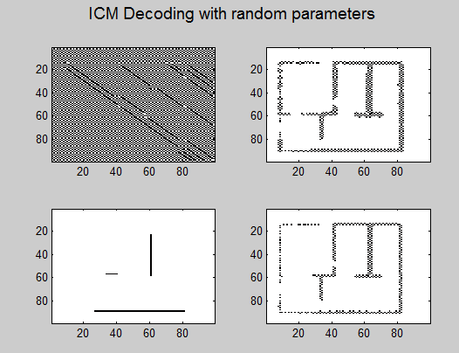
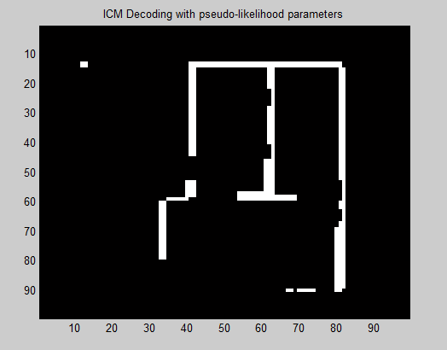
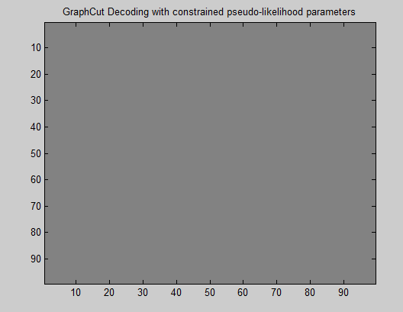
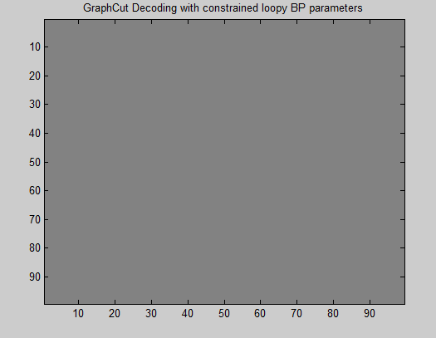
UGM Train Approx – Pseudo-likelihood & Associative CRF & Variational Inference for training
Edge pot = [1,1,1,1]
Node pot = [1,1]

Slide 4
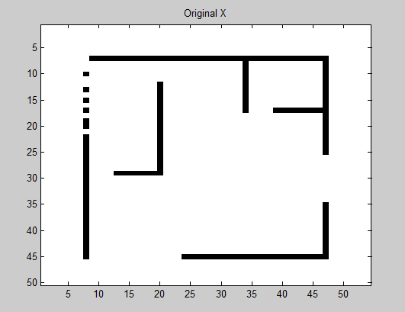
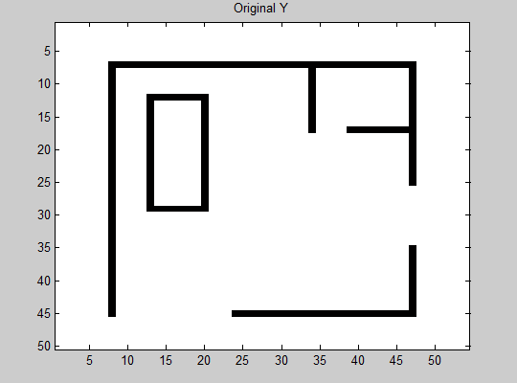
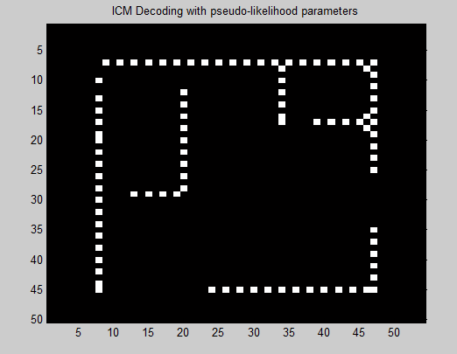
UGM Train Approx – Pseudo-likelihood training
Edge pot = [3.0676 1.0000, 1.0000 3.0676]
Node pot = [1.28462544485701,1]

Slide 5
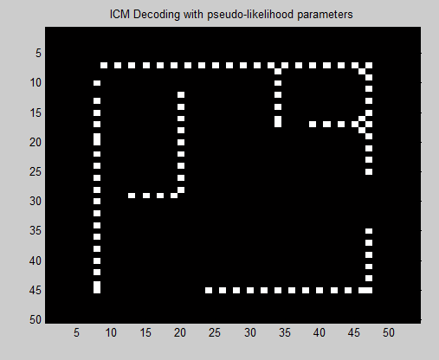
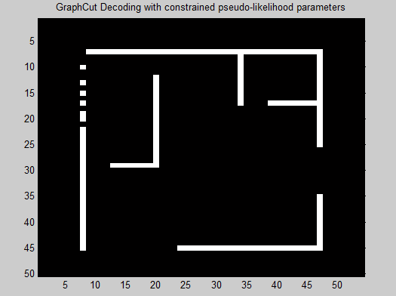
UGM Train Approx – Associative CRF
Edge pot = [1.0000 1.0000, 1.0000 1.0000]
Node pot = [78.2500518584111 1]

Slide 6
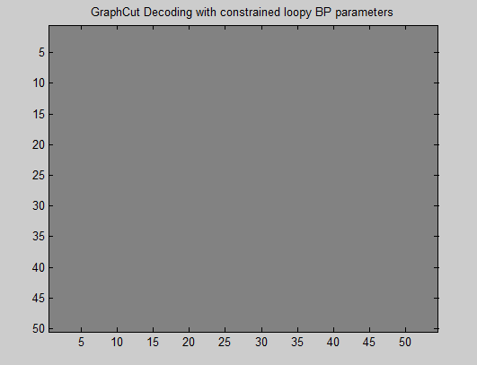
UGM Train Approx – Variational Inference for training
Edge pot = [1.0000 1.0000, 1.0000 1.0000]
Node pot = [1 1]

Slide 7
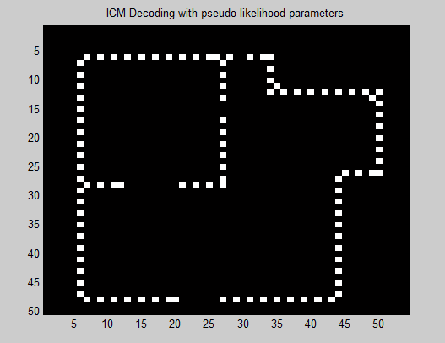
UGM Train Approx – Pseudo-likelihood training
Edge pot = [3.1388 1.0000; 1.0000 3.1388]
Node pot = [1.28442906745803 1]

Slide 8
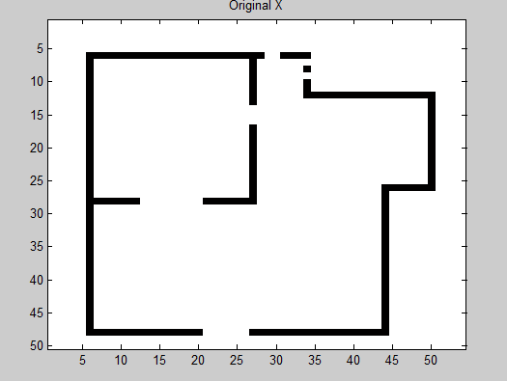
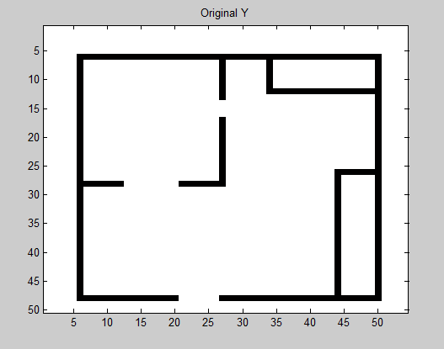
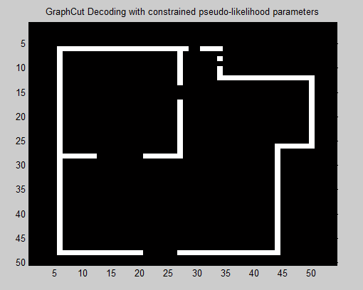
UGM Train Approx – Associative CRF
Edge pot = [2.1932 1.0000; 1.0000 2.1932]
Node pot = [2.37568245072345 1]

Slide 9
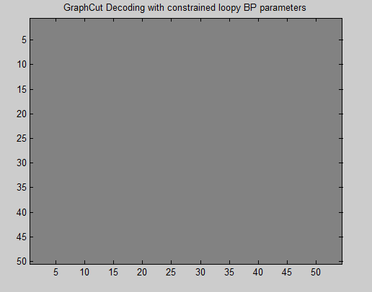
UGM Train Approx – Variational Inference for training
Edge pot = [1.0000 1.0000, 1.0000 1.0000]
Node pot = [1 1]

